Slide 1
e-ATA Carnet

Slide 2


e-ATA Carnet
As on 1st June 2026, all EU member states, Norway, Switzerland and the UK - will begin transitioning from traditional paper ATA Carnets to a new e-ATA Carnet format.

Slide 3
What is an e-ATA Carnet?
It's simply a digital version of the Carnet you already use, which can be downloaded and stored on a smartphone, tablet, or desktop using an ID and PIN code. This allows you to access your Carnet anytime, anywhere, making the process even more convenient and secure.

Slide 4
When is India switching to e-ATA Carnets?
India is planning to transition to e-ATA Carnets in 2026/2027. The global transition is expected to conclude by December 2027, with the entire system becoming fully digital by 2028.
During this transition period, both paper and digital Carnets will coexist. Carnet holders should be prepared to use either format depending on their travel destinations and requirements.

Slide 5
What is the scenario for Indian Carnet Holders?
Carnet Holders should use the paper format in India (Export & Re-Import) till there is an official announcement by the Indian Customs & FICCI on e-Carnet implementation.
Carnet holders should use the digital carnet in EU member states, Norway, Switzerland and the UK.
Continue to use the Physical Carnet in other member countries.

Slide 6
How will the ATA Carnet Work for India to EU Member States, Norway, Switzerland, and the UK (Digital Countries)?
Step 1 — Application (unchanged): Carnet holders will continue to apply online through www.atacarnet.in just as they do today. There are no changes to the application process.
Step 2 — FICCI issues a physical carnet along with an e-ATA ID and PIN to the Carnet Holder.
Step 3 — Download to wallet: The holder downloads the Carnet issued by FICCI into their smartphone wallet using the ATA Carnet app. If needed, the holder can securely share the Carnet with their representative. The digital Carnet is encrypted and is never transmitted in an unencrypted format over the network, ensuring data security at all times.
Step 4 – Exit from India –The Holder presents the physical carnet to the Indian Customs Official. Customs checks the data printed in the physical carnet, signs the paper counterfoil, and gives the paper carnet back to the holder/representative so he/she can verify the entry made by the Customs official. The customs also signs and detaches the paper voucher from the carnet to record the transaction.
Step 5 — Entry into Digital Countries: At border crossings, the Carnet holder or their representative unlocks their digital wallet and displays a QR code that is linked to a specific Carnet and transaction. These QR codes serve as a digital replacement for the paper counterfoils and vouchers traditionally used, streamlining the customs process.
Step 6 — Customs verification: The customs officer scans the ATA Carnet QR code or inputs the Carnet ID and transaction code, views the detailed information, and confirms transactions.
Step 7 — Exit from Digital Countries: At border crossings, the Carnet holder or their representative unlocks their digital wallet and displays a QR code that is linked to a specific Carnet and transaction. These QR codes serve as a digital replacement for the paper counterfoils and vouchers traditionally used, streamlining the customs process.
Step 8 — Customs verification: The customs officer scans the ATA Carnet QR code or inputs the Carnet ID and transaction code, views the detailed information, and confirms transactions.
Step 9 — Digital confirmation: The transaction is digitally recorded, and a confirmation is sent to the holder or representative's smartphone.
Step 10 – Re-entry into India –The Holder presents the physical carnet to the Indian Customs Official. Customs checks the data printed in the physical carnet, signs the paper counterfoil, and gives the paper carnet back to the holder/representative so he/she can verify the entry made by the Customs official. The customs also signs and detaches the paper voucher from the carnet to record the transaction.

Slide 7
How to transact digital Carnets

Slide 8
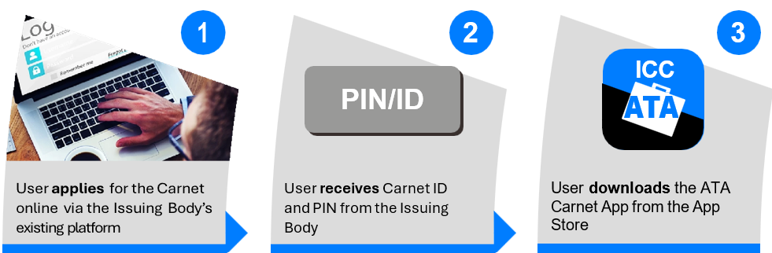
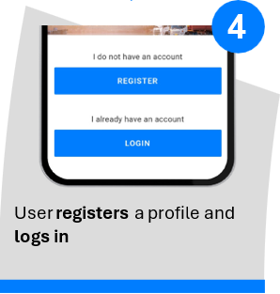

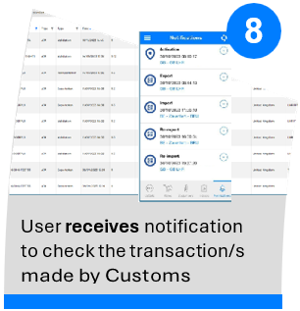
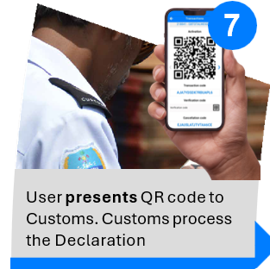
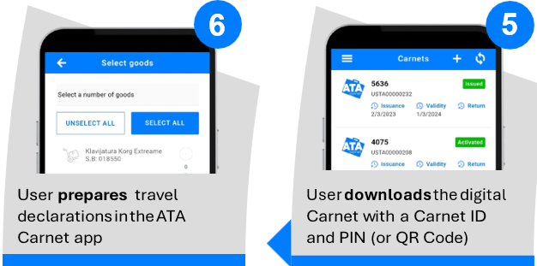


e-ATA Carnet Concept

Slide 9
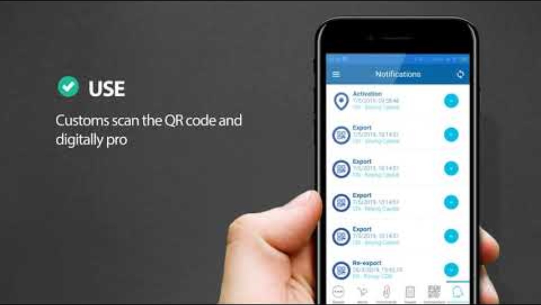

Slide 10
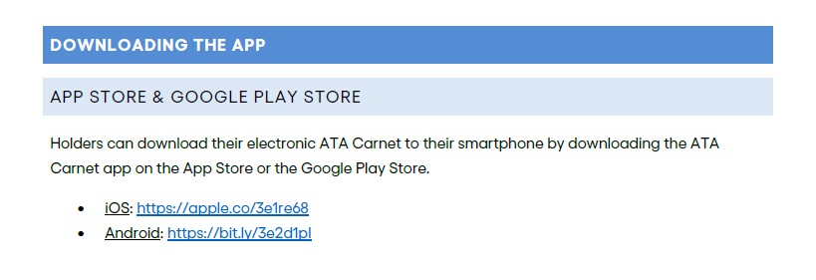
Download the ATA Carnet App

Slide 11
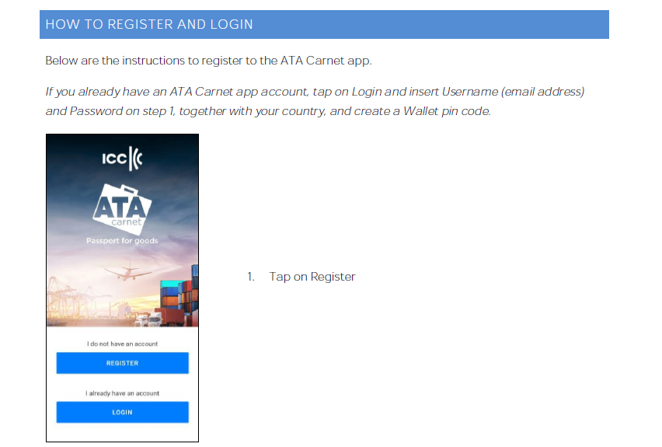
How to Register and Login

Slide 12
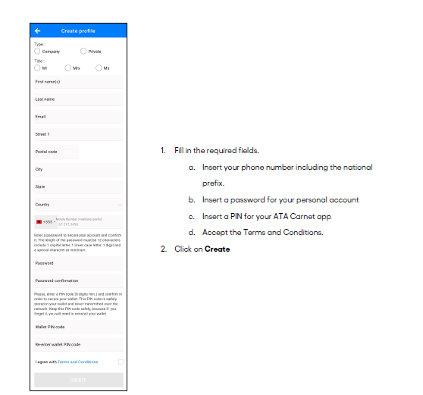
Create your profile

Slide 13
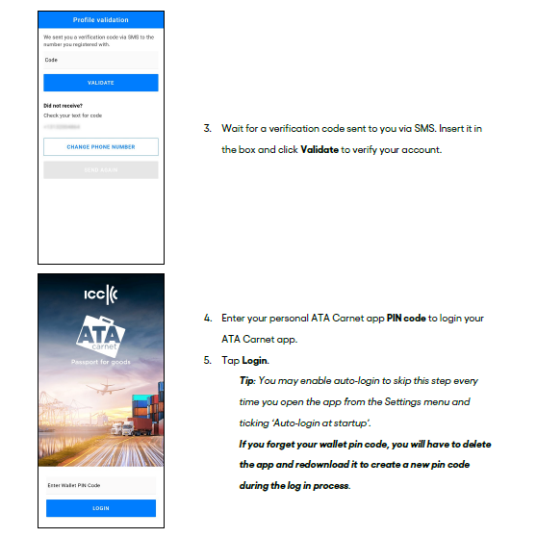
Create your profile

Slide 14
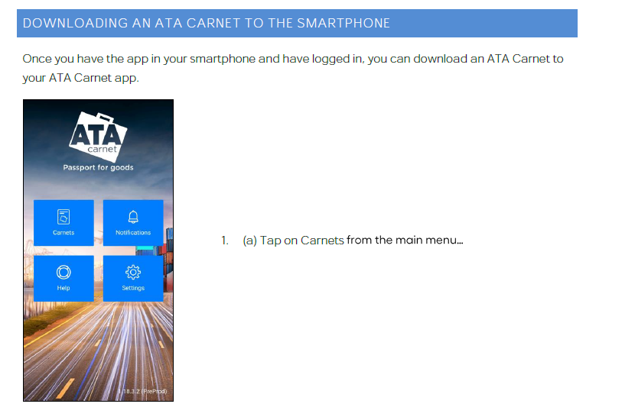
Download an ATA Carnet to your ATA Carnet App

Slide 15


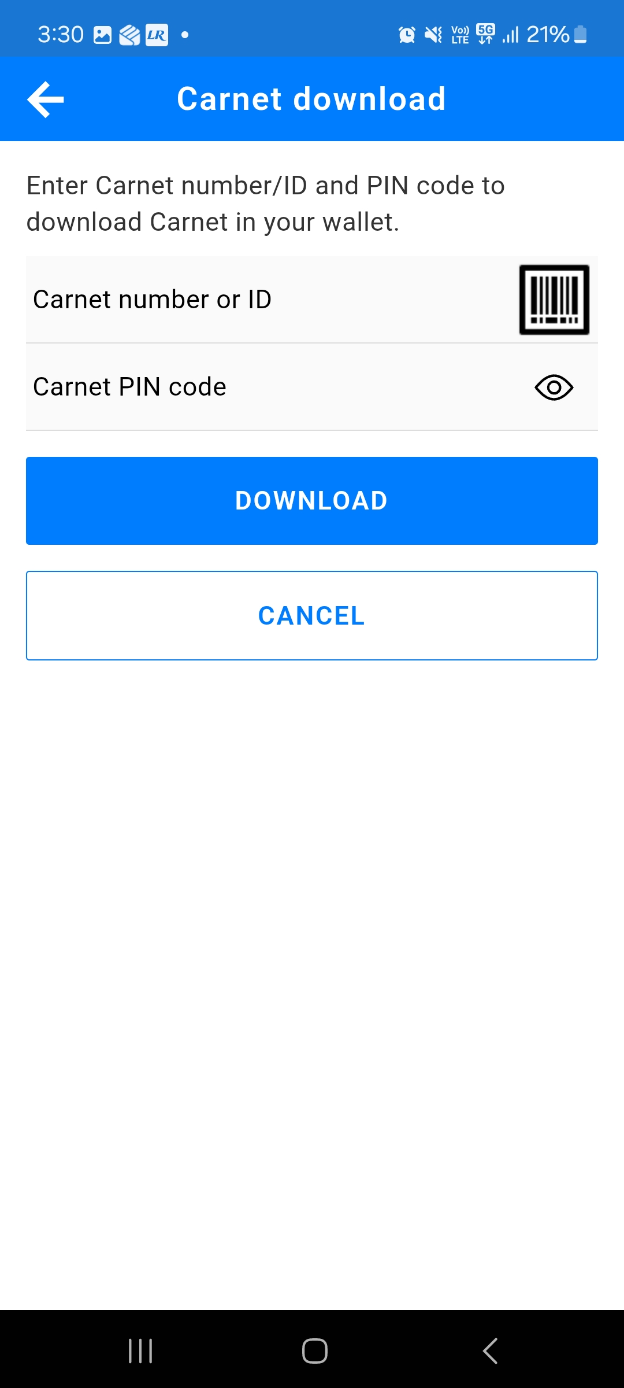
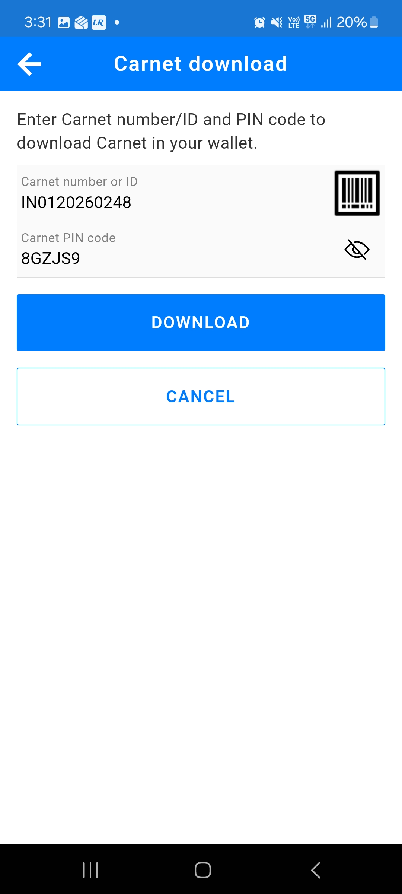
Insert Carnet Number or Carnet ID and Carnet PIN Code as provided by FICCI
Insert Carnet number or Carnet ID and Carnet PIN Code as provided by FICCI
Tap on Download
Alternatively, you may also scan the QR Code by tapping the barcode icon for a faster importation, if provided

Slide 16
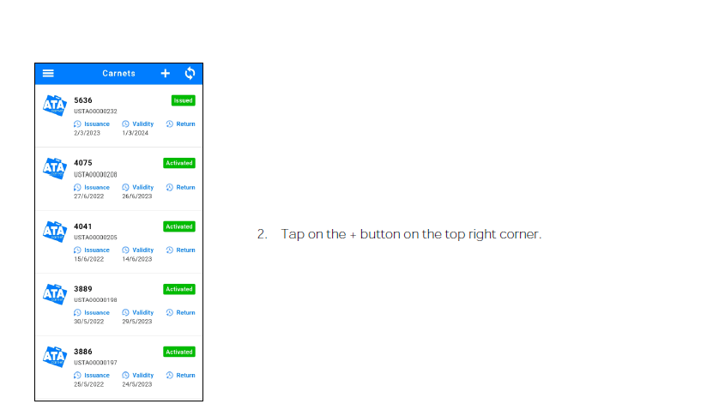
Tap on the +button on the top right corner

Slide 17
Activate a Carnet (Validation)
Before you can prepare a travel and commit transactions, the carnet needs to be activated, just as one would validate a carnet. To do so, simply create a travel by following the steps in the next two chapters and use the Activation QR Code first when going through customs check

Slide 18
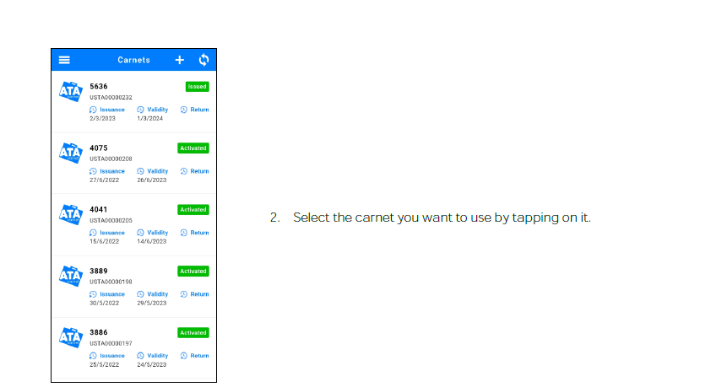
Prepare Travel Declarations

Slide 19
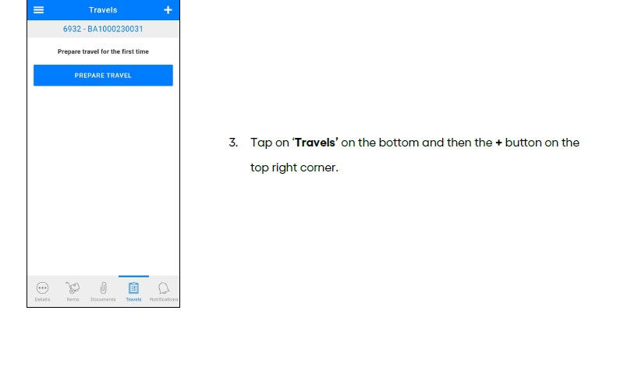

Slide 20
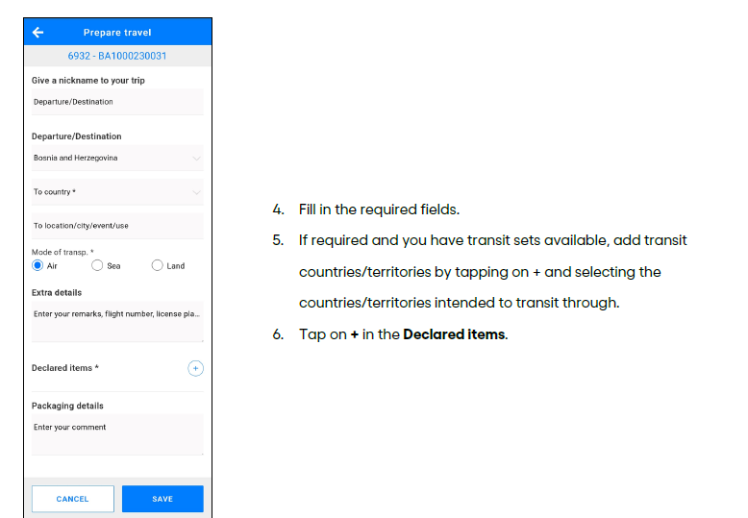

Slide 21
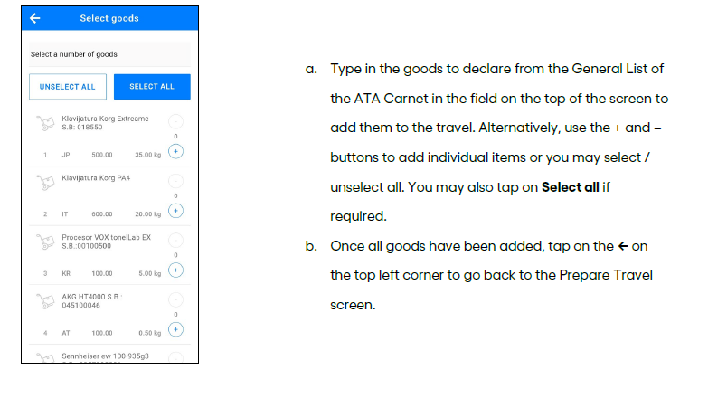

Slide 22
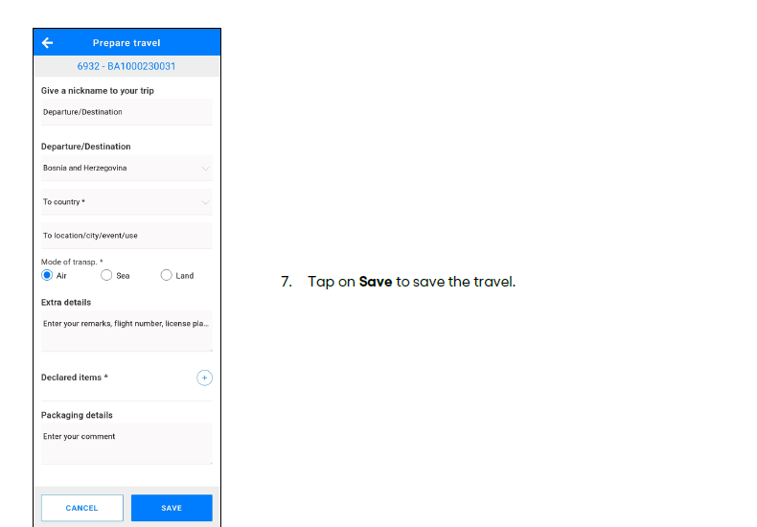

Slide 23
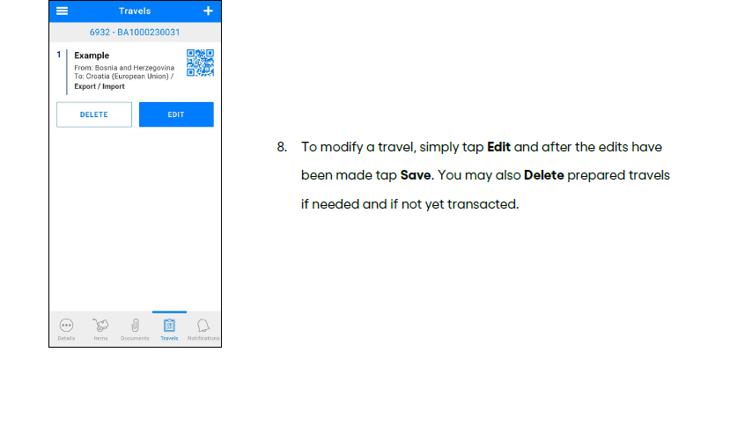

Slide 24
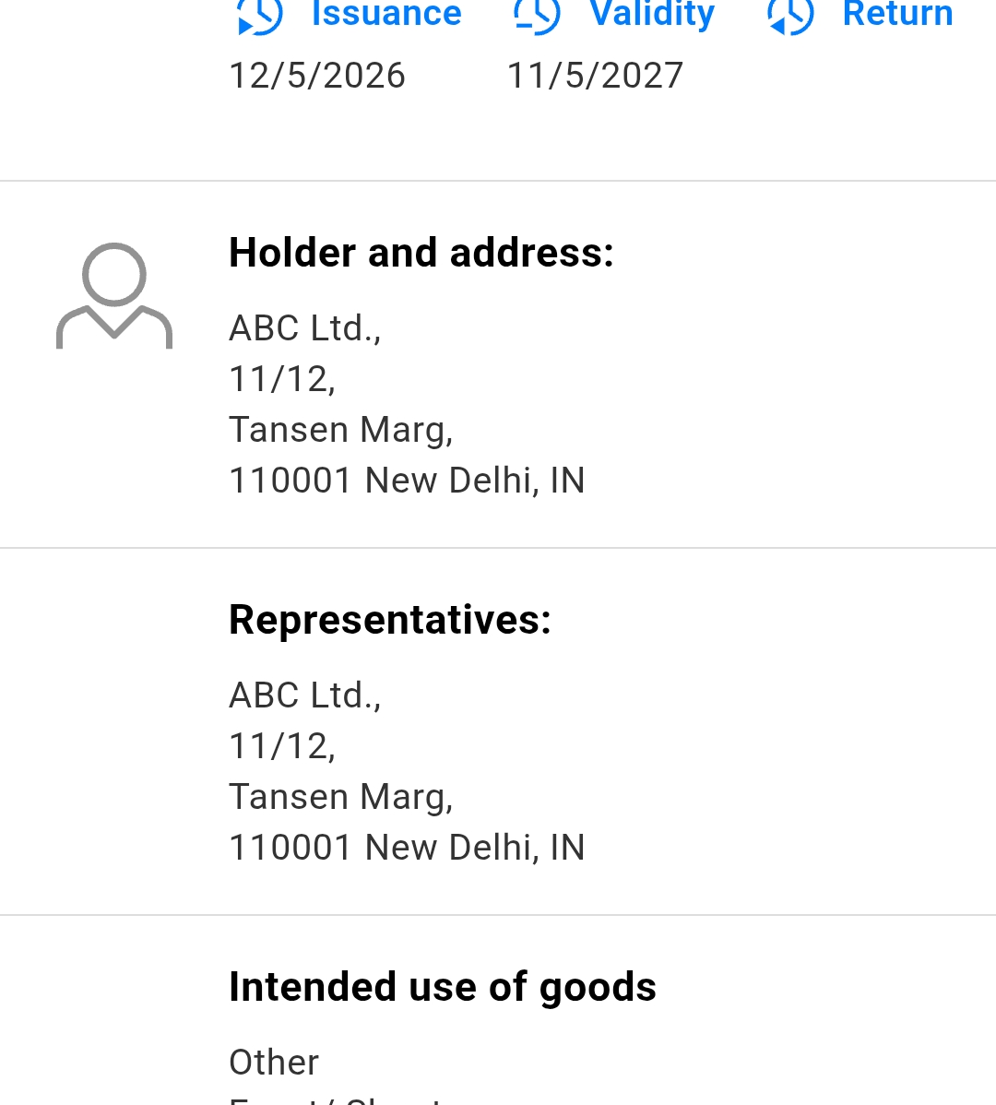
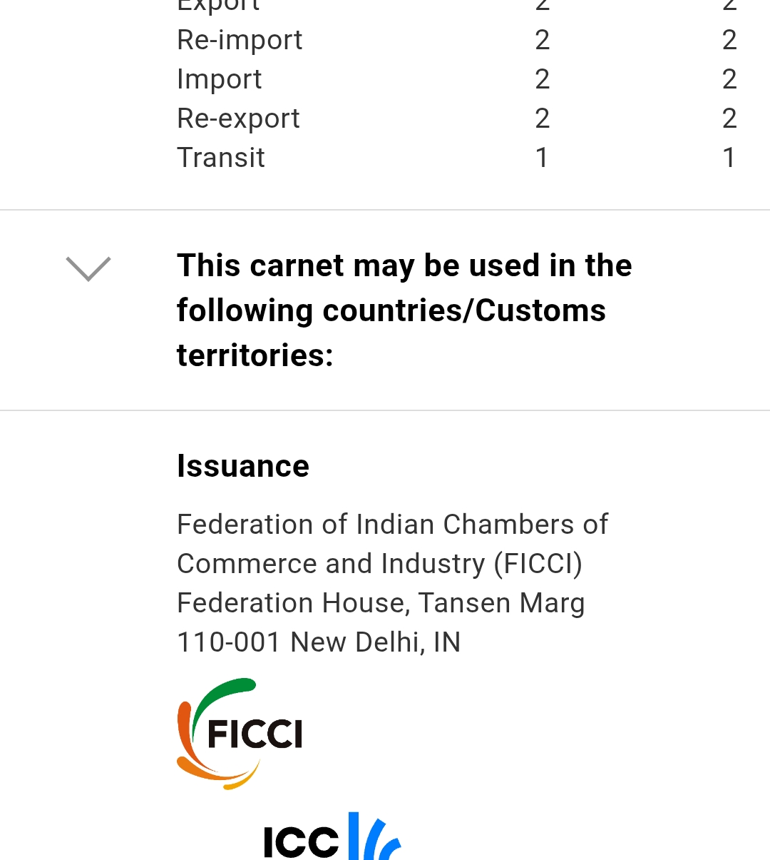
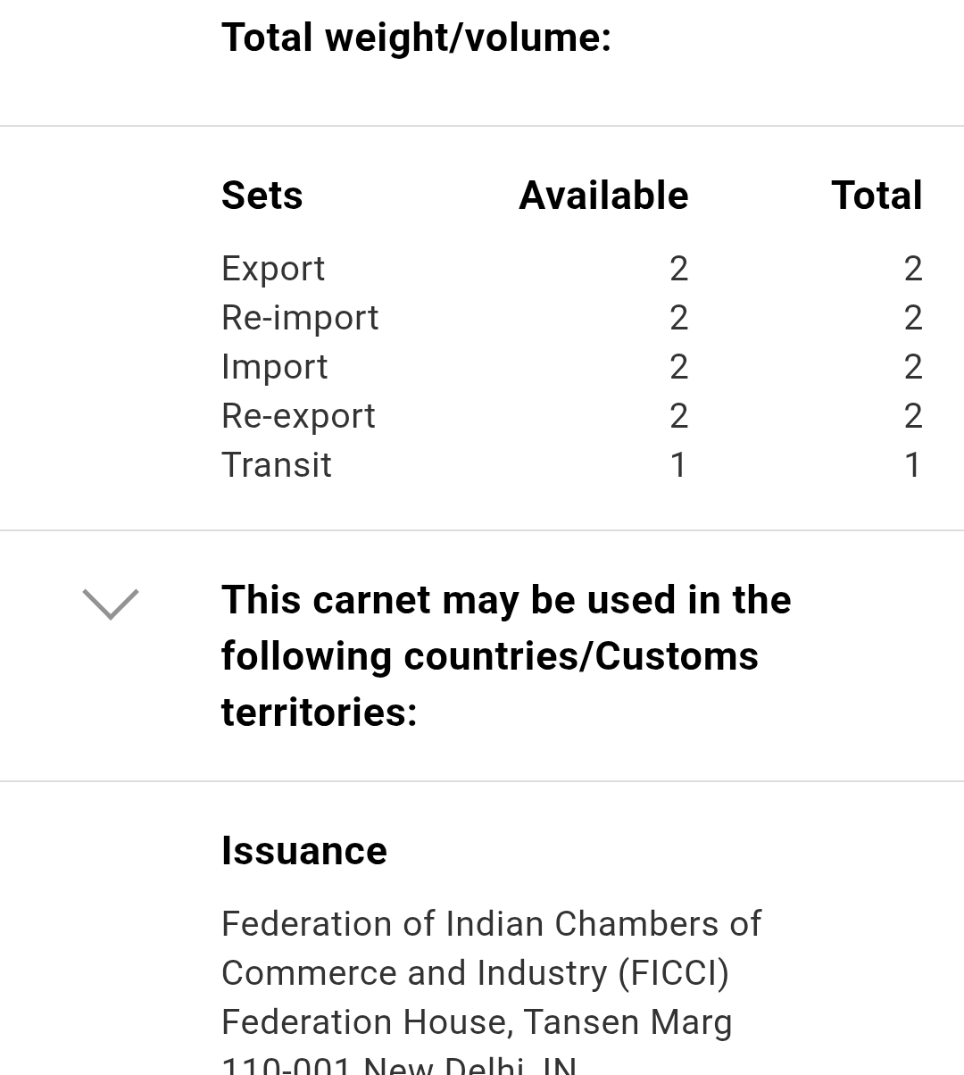
DETAILS OF CARNET
ATA Carnet App – Carnet Holder

Slide 25
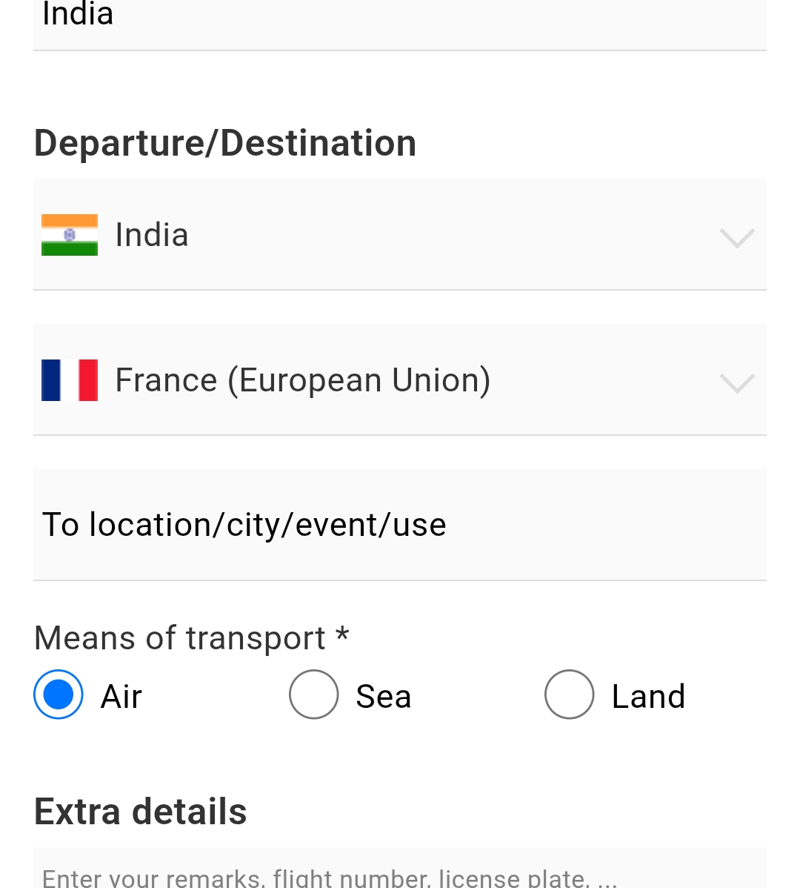
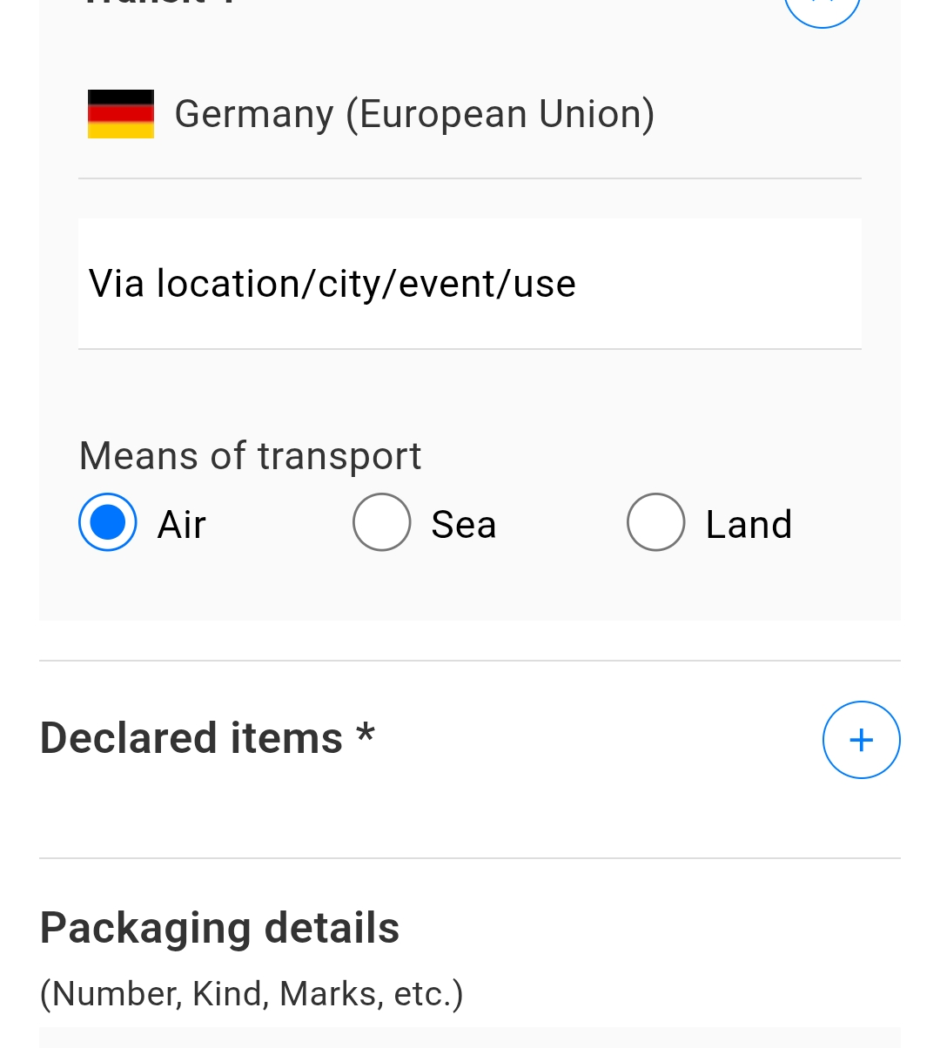
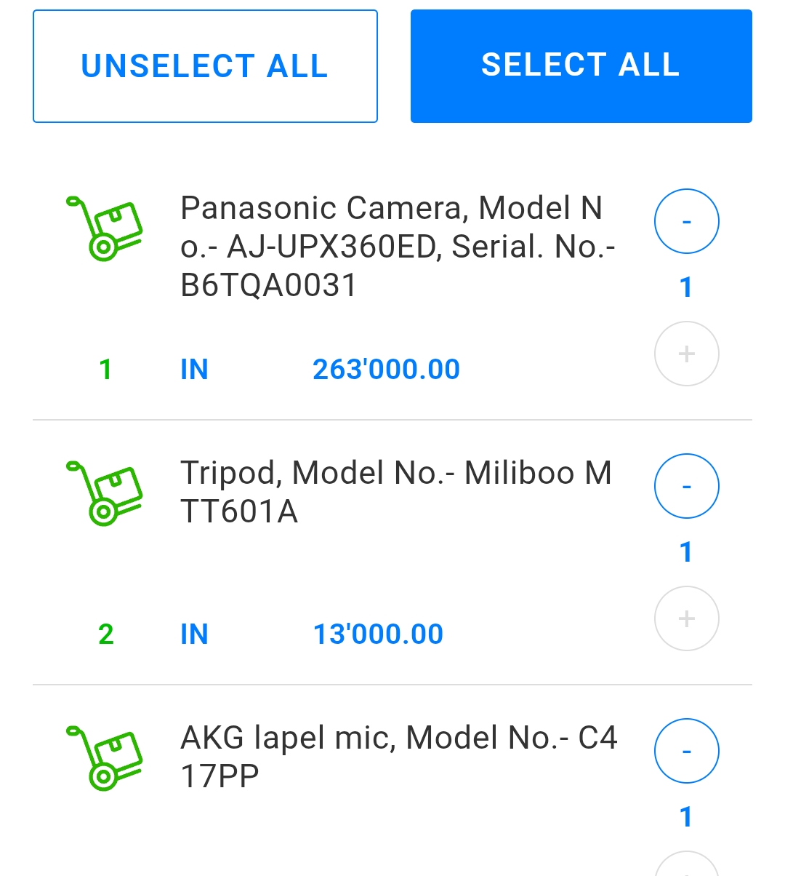
DETAILS OF CARNET
ATA Carnet App – Carnet Holder

Slide 26
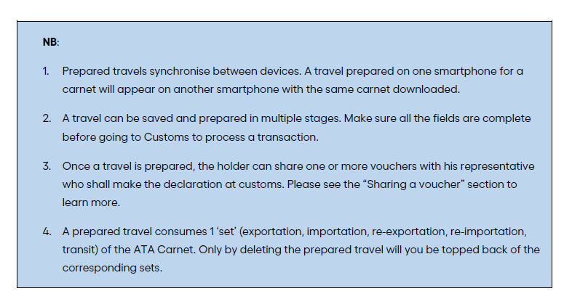

Slide 27
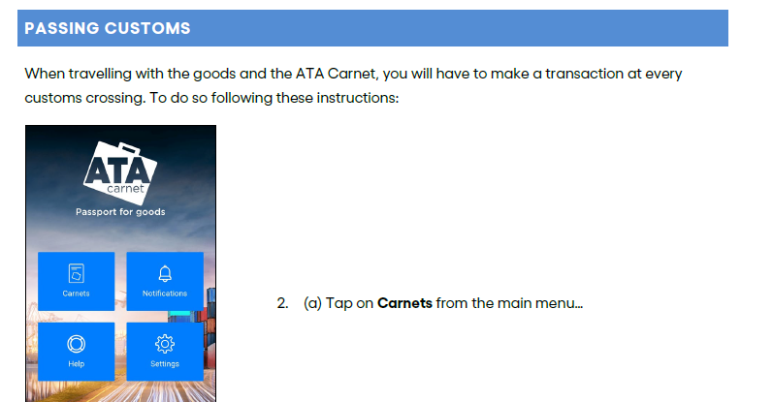

Slide 28
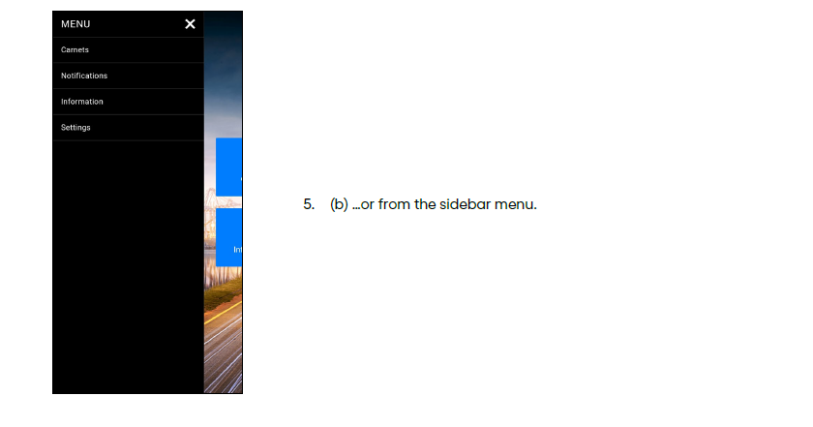
PASSING CUSTOMS

Slide 29
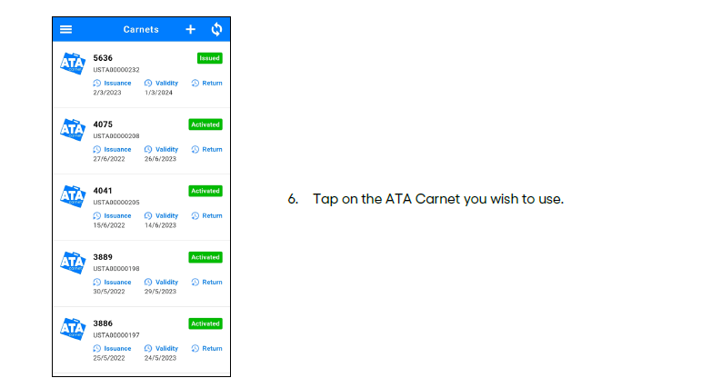
PASSING CUSTOMS

Slide 30
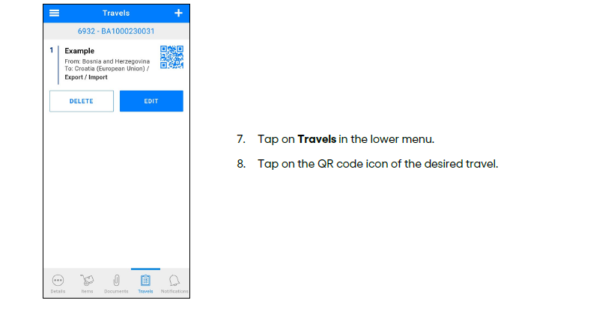
PASSING CUSTOMS

Slide 31
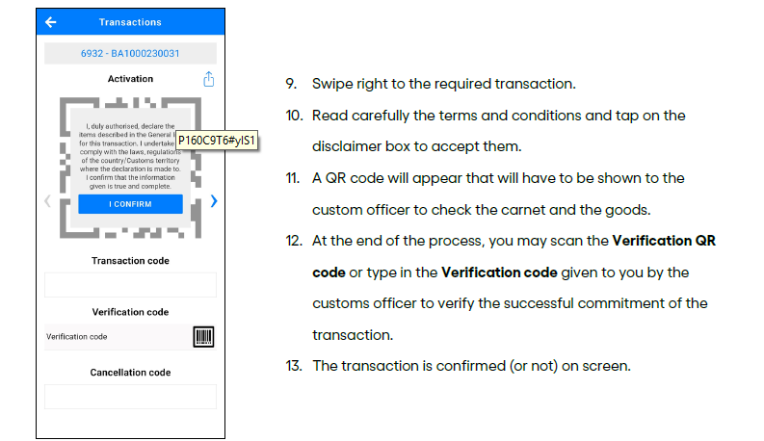
PASSING CUSTOMS

Slide 32
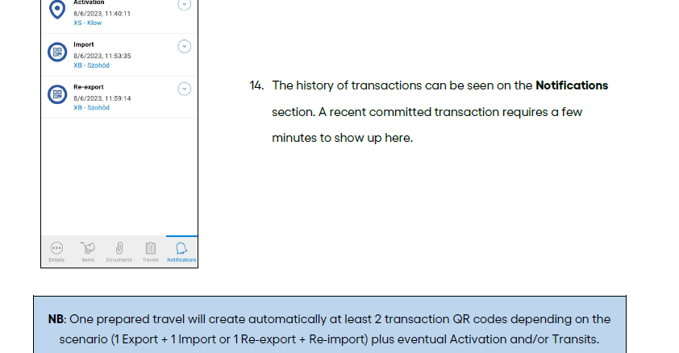
PASSING CUSTOMS

Slide 33
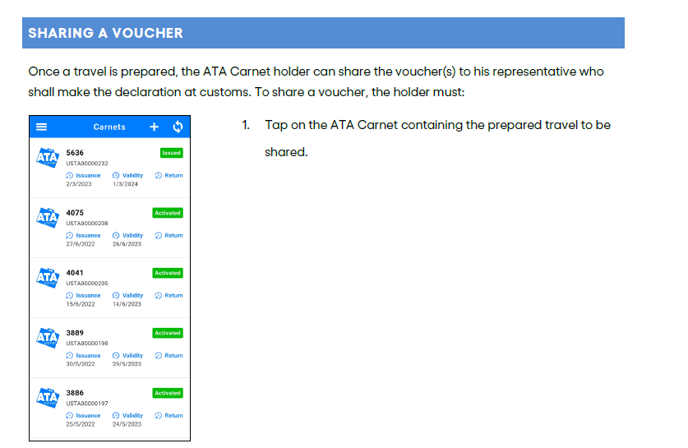
SHARING A VOUCHER

Slide 34
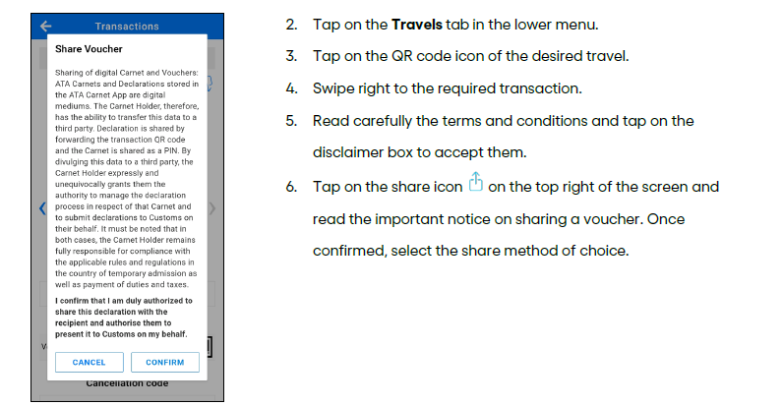

Slide 35
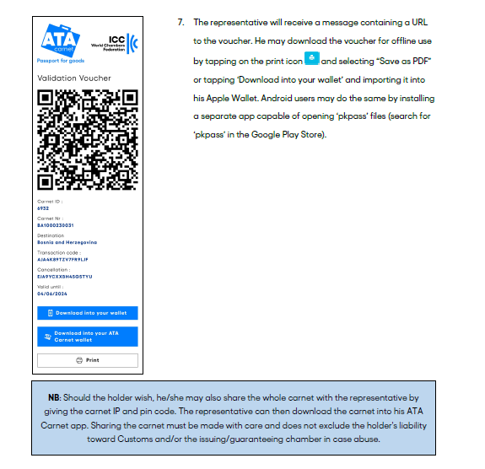
SHARING A VOUCHER

Slide 36
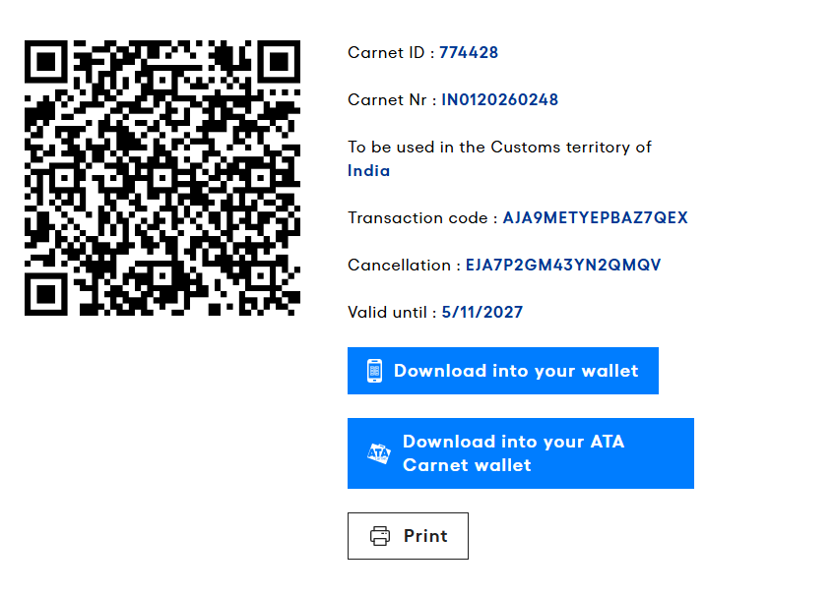
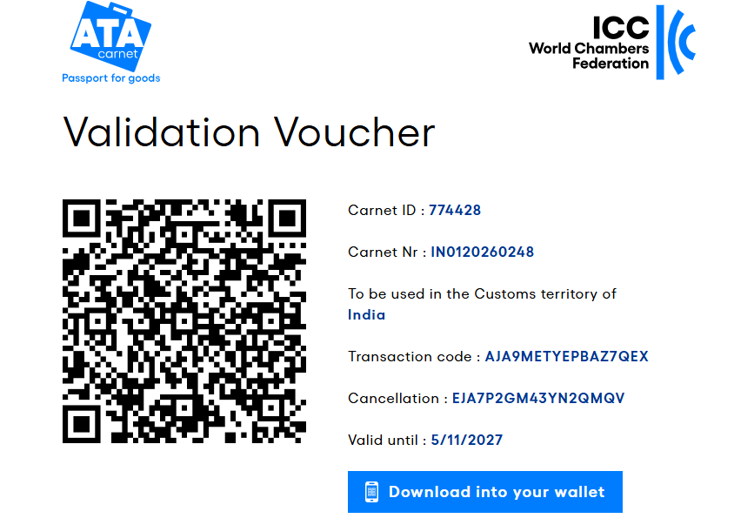
Validation Voucher – Currently not to be used by Indian carnet holders, as the front page of the Physical carnet to be validated in India.

Slide 37
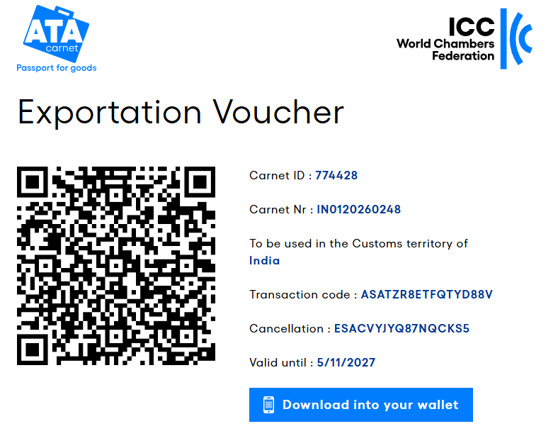
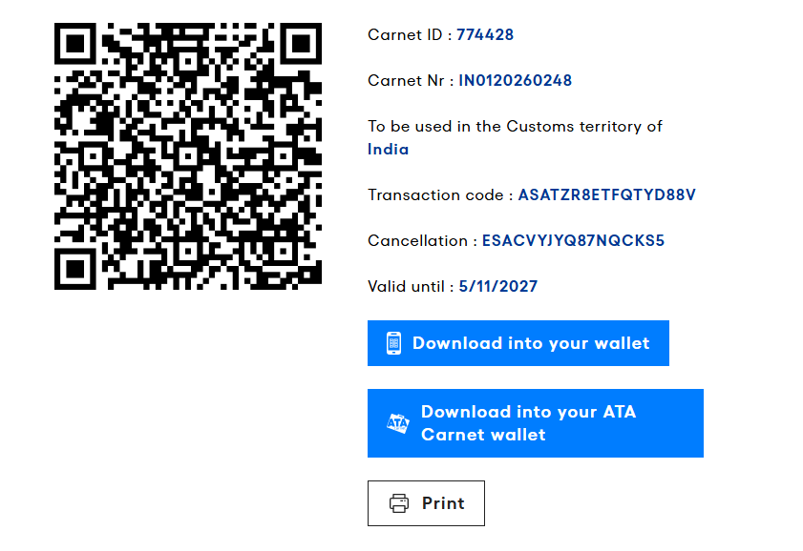
Exportation Voucher – Currently not to be used by Indian carnet holders, as the Exportation Voucher & Counterfoil of the Physical carnet are to be validated & endorsed in India.

Slide 38
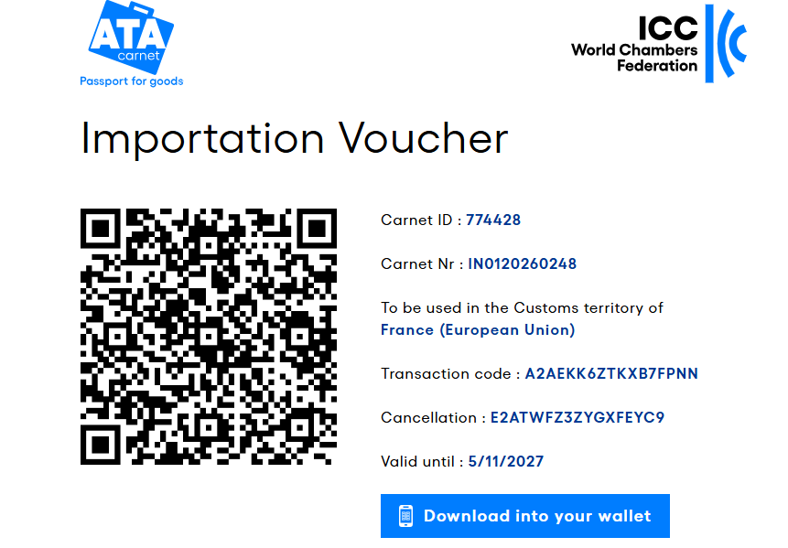
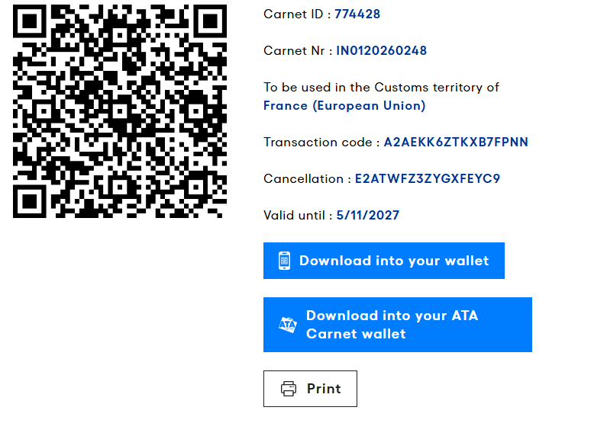
Importation Voucher – To be presented to the Customs in Digital Countries (EU, Norway, Switzerland and the UK) at the time of importation

Slide 39
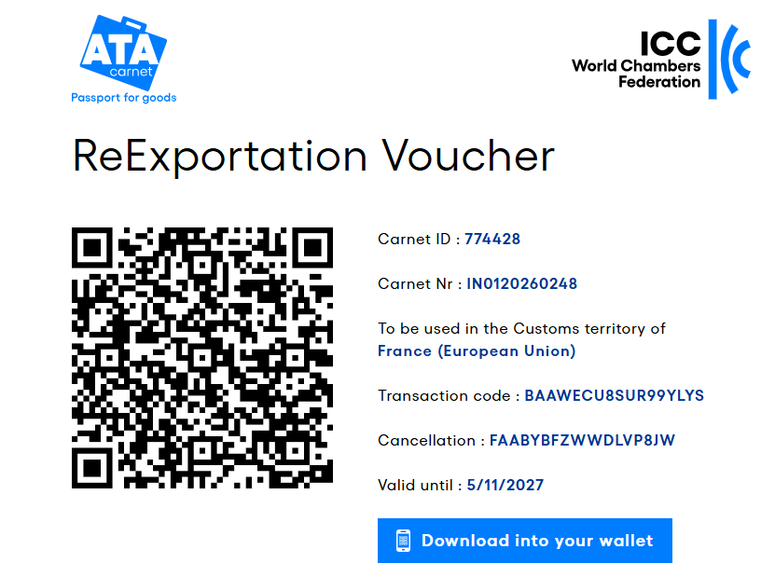
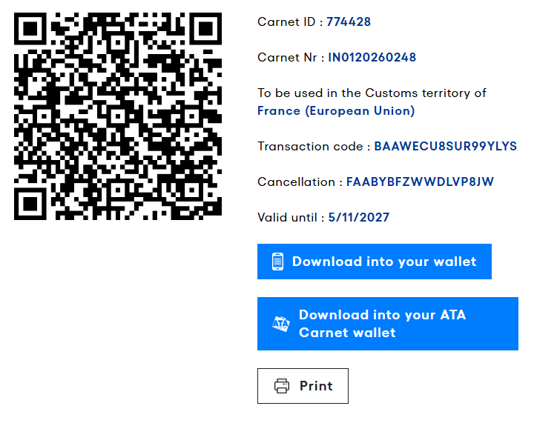
Re-Exportation Voucher – To be presented to the Customs in Digital Countries (EU, Norway, Switzerland and the UK) at the time of re-exportation

Slide 40
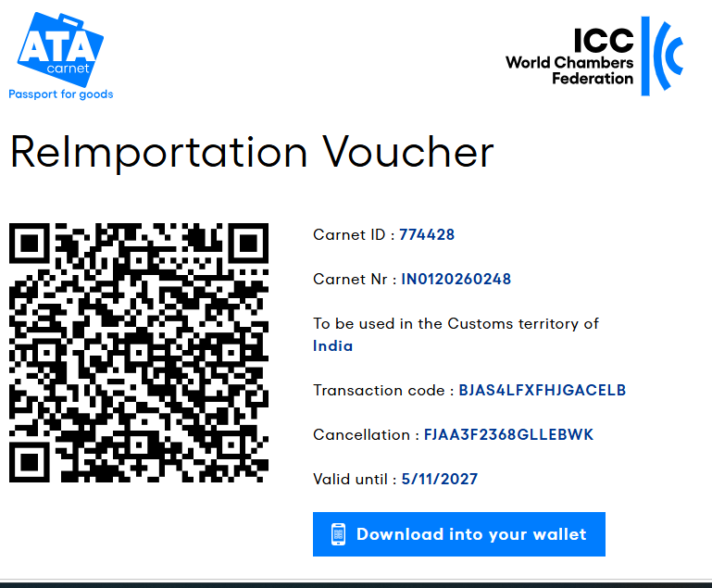
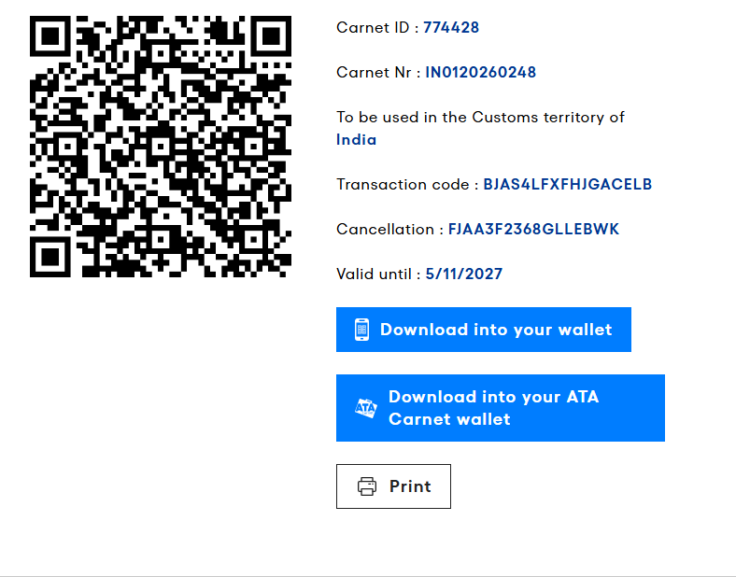
Re-importation Voucher – Currently not to be used by Indian carnet holders, as the Reimportation Voucher & Counterfoil of the Physical carnet are to be validated & endorsed in India.

Slide 41
Concepts of the Global Transition Plan
Different Use Cases During the Transition Phase:
Detailed use cases for various scenarios, including transitions from paper-to-paper countries, paper to digital countries, digital to digital countries, and digital to paper countries.
Each use case explains the actions required by holders, IAs, and Customs in different situations.
Notes:
GTP is available in ACC and is sent to all SPOCs

Slide 42
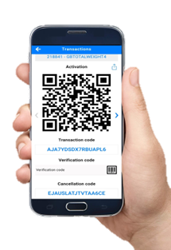
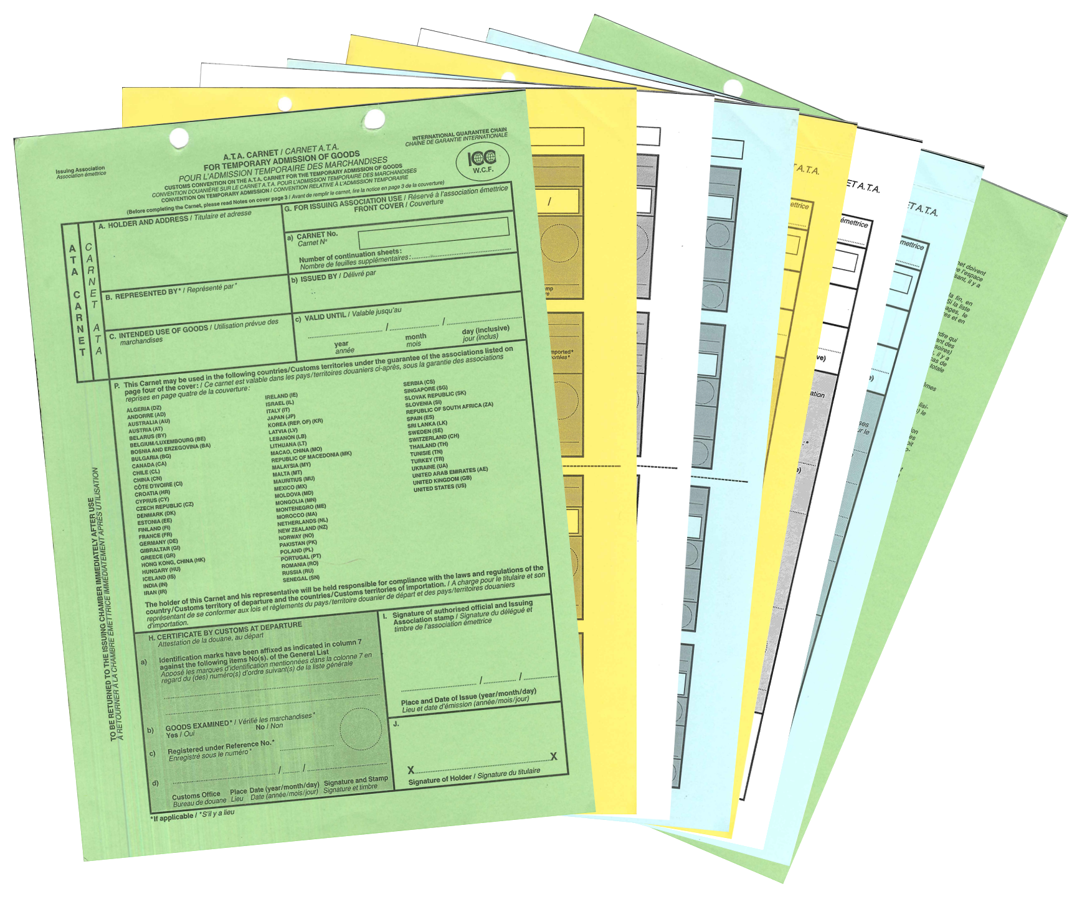
Itinerary containing DIGITAL countries only
Itinerary containing DIGITAL and PAPER countries
Itinerary containing PAPER countries only
use
use
use
use

Slide 43




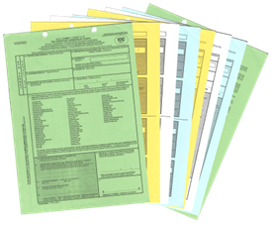

Paper country to paper country | Paper country ‘A’ | Paper country ‘B’ | Paper country ‘A’
Issuance | Validation Exportation | Importation Re-exportation Transit in Transit out | Re-importation
IA
Notes:
From a PAPER Country to PAPER Country(ies)

Slide 44

Paper country to digital country | Paper country ‘A’ | Digital country ‘B’ | Paper country ‘A’
Issuance | Validation Exportation | Importation Re-exportation Transit in Transit out | Re-importation
 |  | Optionally verify paper carnet validation from departure country. Recognize evidence from both paper and digital countries for claims.
IA
Notes:
From a PAPER Country to DIGITAL Country(ies)

Slide 45
Digital to digital country | Digital country ‘A’ | Digital country ‘B’ | Digital country ‘A’
Issuance | Validation Exportation | Importation Re-exportation Transit in Transit out | Re-importation
 |  | Recognize evidence from within and outside the system certified by Customs administrations.
IA
Notes:
From a DIGITAL Country to DIGITAL Country(ies)

Slide 46
Digital country to paper country | Digital country ‘A’ | Paper country ‘B’ | Digital country ‘A’
Issuance | Validation (ATA + eATA) Export only done on eATA | Importation Re-exportation Transit in Transit out | Re-importation
 | Validation done both on digital and on paper | Note stamped green cover indicating activation in departure country. No record of exportation in paper carnet due to digital transaction.
IA
Notes:
From a DIGITAL Country to PAPER Country(ies)

Slide 47

Paper country to mixed itinerary | Paper country ‘A’ | Digital country ‘B’ | Paper country ‘C’ | Paper country ‘A’
Issuance | Validation Exportation | Importation Re-exportation Transit in Transit out | Importation Re-exportation Transit in Transit out | Re-importation
 |  | Note: Activation done in departure paper country under linked paper carnet. Recognize evidence from both paper and digital countries for claims.
IA
Notes:
From a PAPER Country to Both PAPER and DIGITAL Countries

Slide 48

Digital country to mixed itinerary | Digital country ‘A’ | Paper country ‘B’ | Digital country ‘C’ | Digital country ‘A’
Issuance | Validation (ATA + eATA) Exportation | Importation Re-exportation Transit in Transit out | Importation Re-exportation Transit in Transit out | Re-importation
 | Validation done both on digital and on paper
IA
Notes:
From a DIGITAL Country to Both PAPER and DIGITAL Countries

Slide 49
For further details, please contact:
FICCI
Federation House,
1 Tansen Marg,
New Delhi – 110 001
Ph: 011 23738760-70 (11 lines), 23497499 (D)
E-mail: atacarnet@ficci.com
Web: www.ficci.com/www.atacarnet.in

Slide 50
Thank you

